Slide 1
OpenMP-Programming training-5
Chun-Yuan Lin

Slide 2
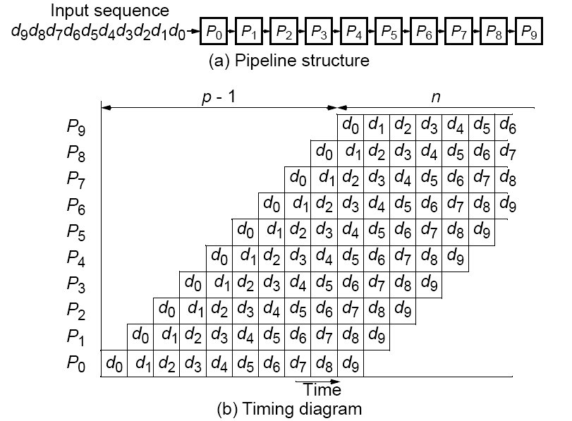
“Type 2” Pipeline Space-Time Diagram

Slide 3
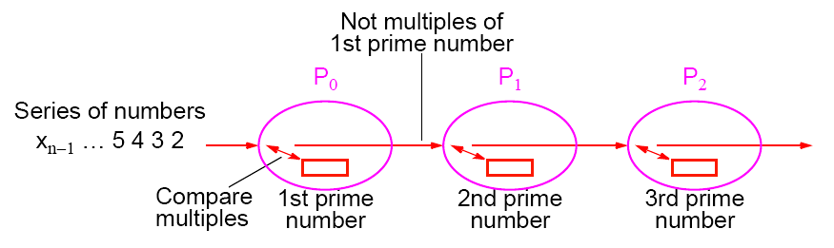
Prime Number Generation
Sieve of Eratosthenes
Series of all integers generated from 2.
First number, 2, is prime and kept.
All multiples of this number deleted as they cannot be prime.
Process repeated with each remaining number.
The algorithm removes non-primes, leaving only primes.
Type 2 pipeline computation

Slide 4
Training
Please write an OpenMP program to find all prime numbers less than 10,000,000,000.
Calculate the speedup ratio for p=2, 4, 8, 16.
Please compare the OpenMP program with your previous MPI program in terms of time and speedup ratio. (for p=2, 4, 8, 16)

Slide 5
Please send the code of this training and the word file with the speedup ratio to my email. (before 5/14, 23:59).
  Please annotate your name and your student ID in email.
  The file name is “student ID”. If more than one file, the names are “student ID-1”, “student ID-2”, etc.
  Please compress the files to a .zip or .rar file. The file name is “student ID-train5”.
For example, a student has ID “A0000001” and two files. The file names are A0000001-1.c and A0000001-2.c and the compressed file name is A0000001-train5.zip.
The file will be rejected without following the rules.

